Slide 1

Cyber Security
Introduction Session
Safeguarding Digital Environments…
PRESENTED BY
DINESH JEEV
Certified: CEH | CEC | ISO27001 Lead Audit | CISA |

Slide 2
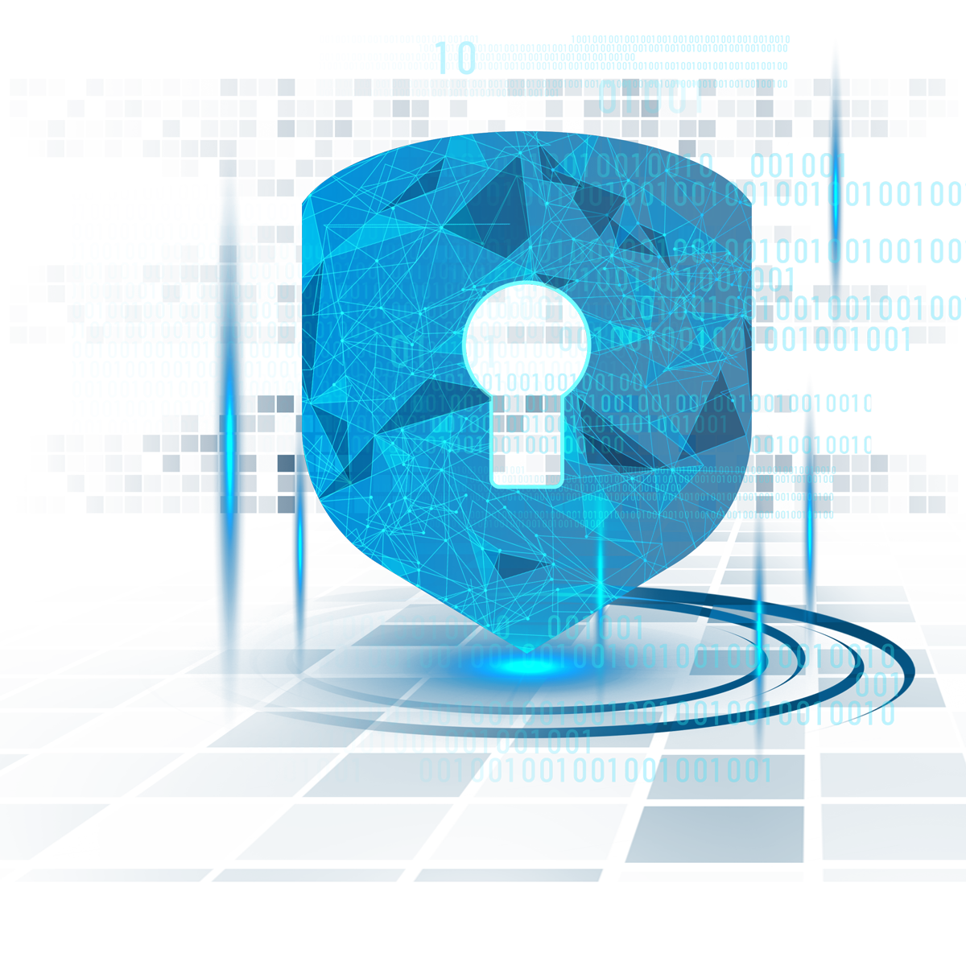
AGENDA
Welcome & Introduction
Importance of cybersecurity
Definition of Cybersecurity
Key components of Cybersecurity
Cybersecurity Technologies and Tools
What is Hacking? Who is a Hacker?
Types of Hackers
What is a Data Breach & Security Breach
Career in Cyber Security

Slide 3


Welcome & Introduction
MYSELF
Over 10 years of seasoned experience in cyber security
Proven track record on achievements and certification on cyber security
Authored “ Scarecrows – A Book for ethical Hacking”
Certified Ethical Hacker & Security Auditor
Trainer & Implementer
$$$$

Slide 4
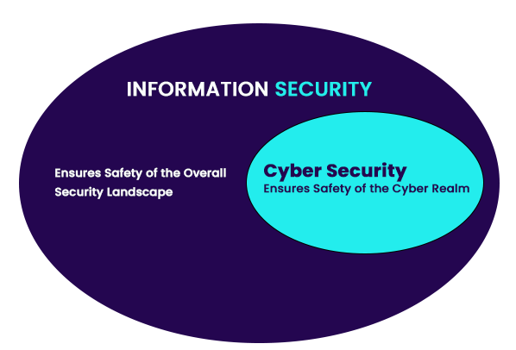
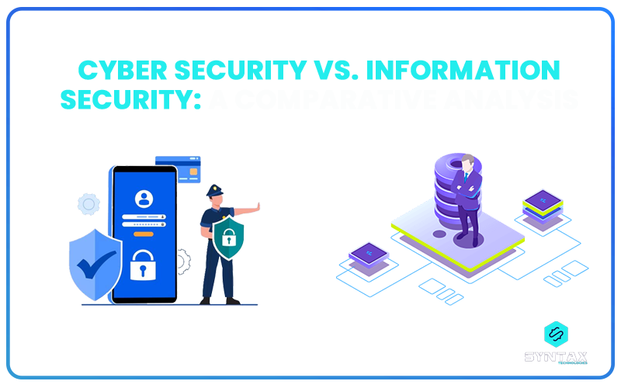
Cyber Security Vs Information Security

Slide 5
What is Information Security?
Processed data is referred to as information. Safeguarding and protecting this information is conducted through the process of Information Security.
It can be understood as the process of according protection to information systems in order to prevent it from being exposed to destruction, disclosure, disruption, modification and unauthorized access.

Slide 6
What is Cyber Security?
Cyber Security can be seen as a discipline which deals with providing protection and security measures to servers, computer systems, mobiles, programs, systems and networks; with the objective of defending them against malicious digital attacks (Cyber Security threats and Cyber Security attacks).
These attacks are essentially aimed at transforming, destroying r acquiring access to critical data; demanding ransom from the owners of data, or seeking to disrupt the normal procedure of business.

Slide 7







Why Cyber security is Important?
CONSEQUENCES
Financial Loss:
Reputation Damage
Regulatory Penalties
Legal Consequences
Operational Disruption
Identity Theft and Fraud
Increased Cybersecurity Costs
Loss of Competitive Advantage
Market Value Decline
Customer Inconvenience and Anguish

Slide 8
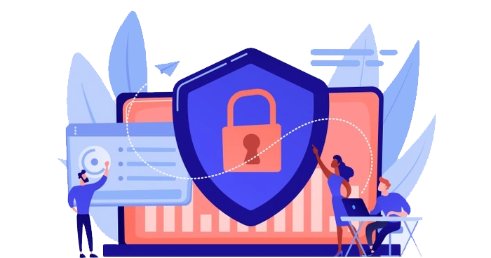
Definition : Cyber Security | Information Security
Cybersecurity is the practice of protecting computer systems, networks, and data from unauthorized access, attacks, and damage, with the goal of ensuring the confidentiality, integrity, and availability of information in the digital realm.
Information security involves safeguarding sensitive data, ensuring its accuracy and confidentiality, and protecting it from unauthorized access or alterations. It encompasses measures and practices designed to secure information in various forms, such as digital or physical, to mitigate risks and maintain the trustworthiness of data.

Slide 9
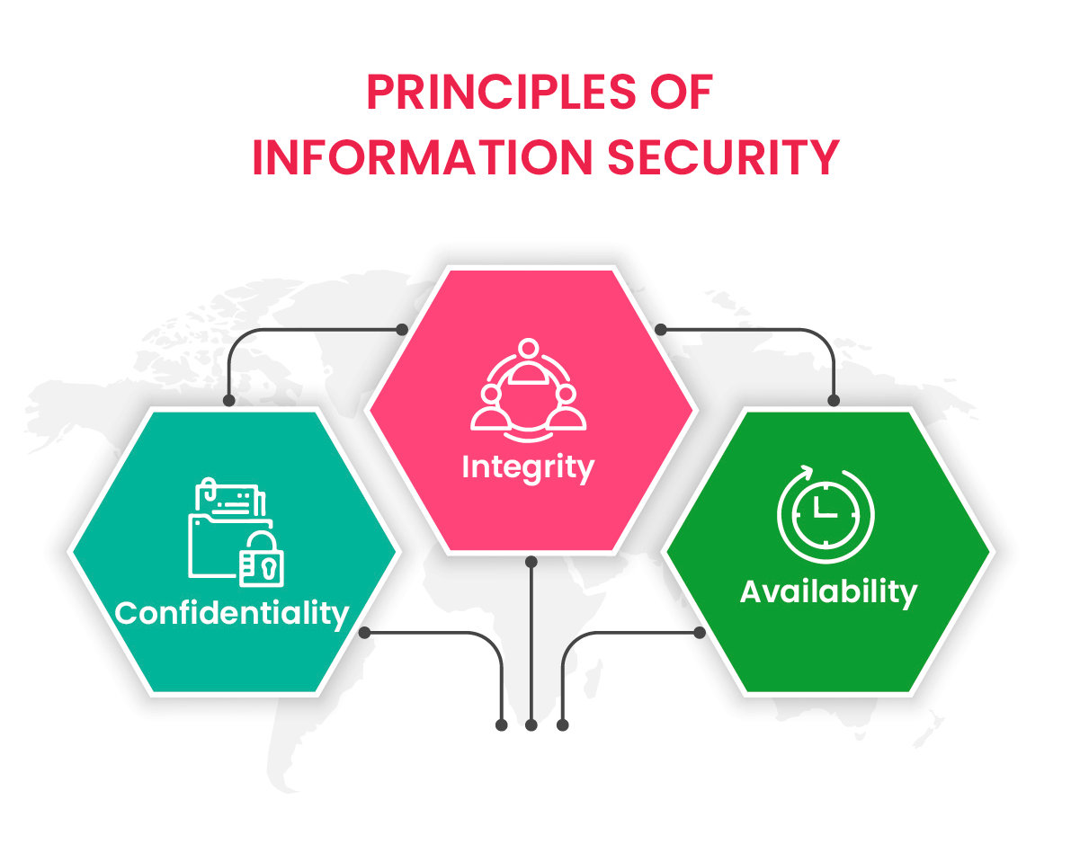
Confidentiality- protecting sensitive information
Integrity - ensuring data accuracy
Availability - ensuring systems are accessible when needed

Slide 10
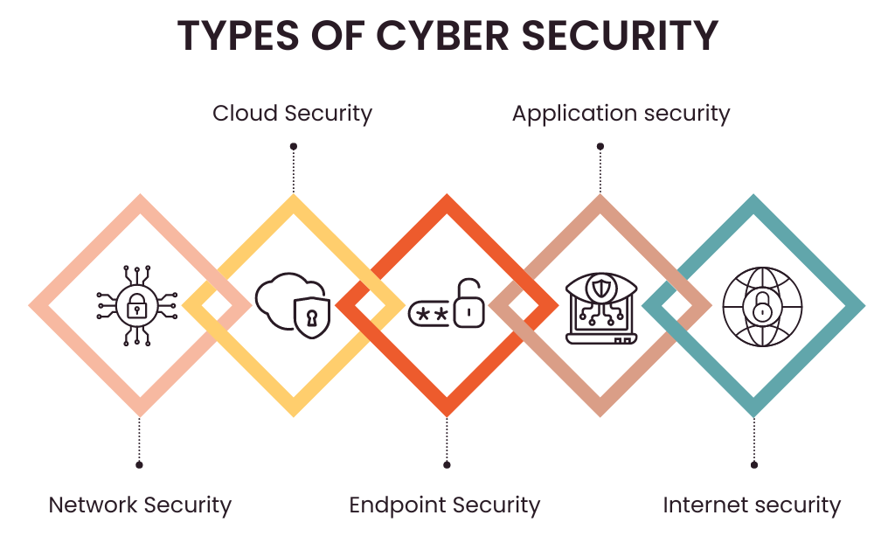

Slide 11
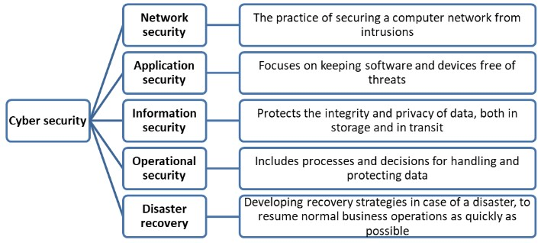
Key Aspects of Cyber Security

Slide 12

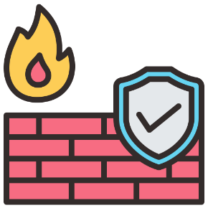
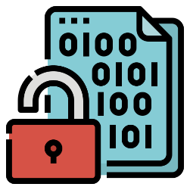
Cybersecurity Technologies and Tools
Antivirus and Anti-malware:
Software designed to detect and remove malicious software.
Firewalls and Intrusion Detection Systems:
Network security measures to monitor and control incoming and outgoing network traffic.
Encryption and its Role in Cybersecurity:
Protecting data by converting it into a code that is unreadable without the proper decryption key.

Slide 13
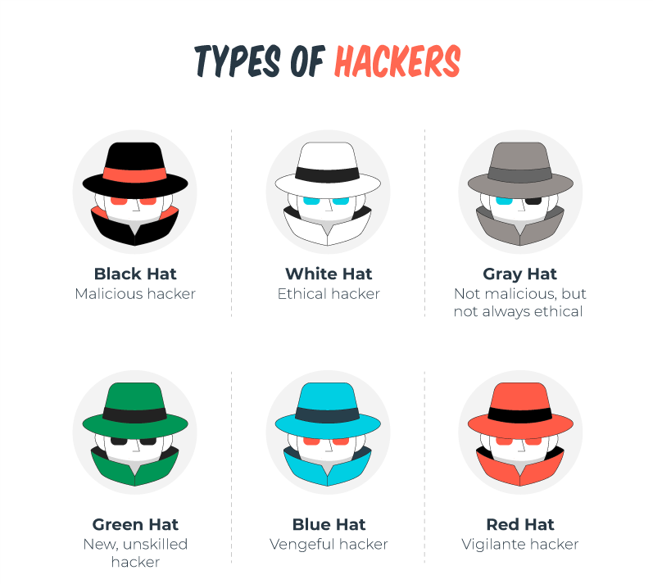
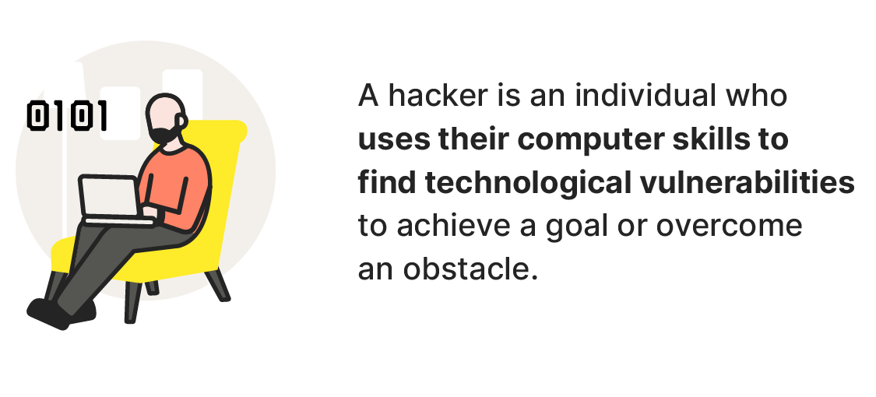

Slide 14
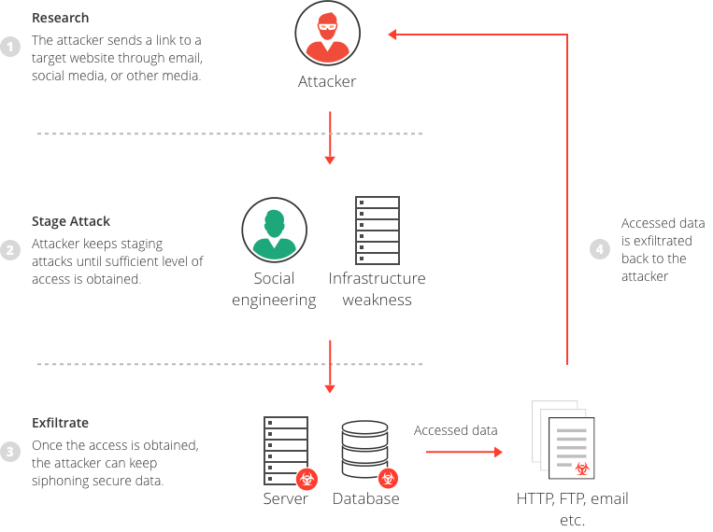
What is Data Breach?
A data breach is any security incident in which unauthorized parties gain access to sensitive data or confidential information, including personal data (Social Security numbers, bank account numbers, healthcare data) or corporate data (customer data records, intellectual property, financial information).

Slide 15
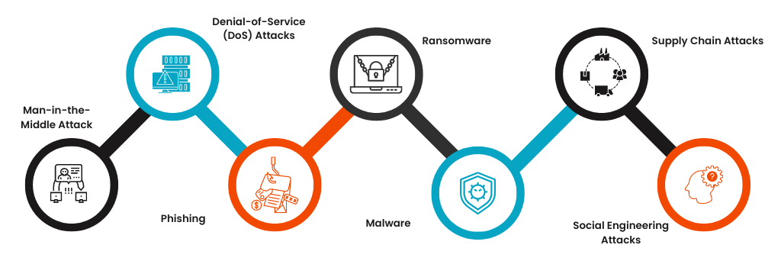
Security Breaches & its types
A security breach means unauthorized access to a device, facility, program, network, or data. It can involve the breach of security measures that protect data, network systems, or physical hardware assets, and it's often the precursor to private data being copied, shared, or stolen in a data breach.

Slide 16
